Slide 1
Arginase KO Mouse Project
Jillian Haney
Gerry Lipshutz, MD
Gloria Nieto, PhD

Slide 2
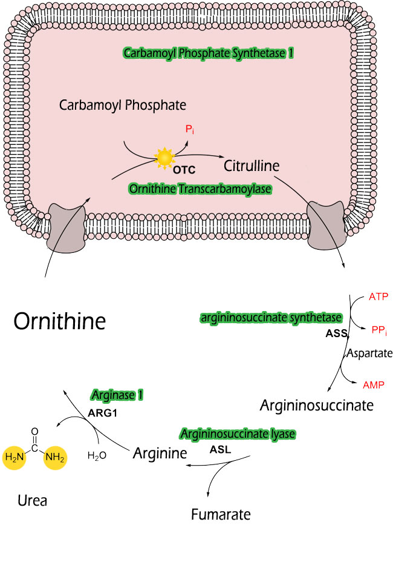
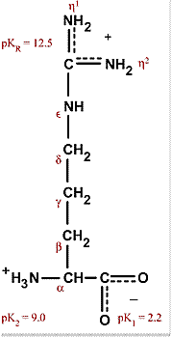
What is Arginase I Deficiency?
Lack of functional arginase in the Urea cycle is what causes excess ammonia and arginine (and likely other guanidino compounds) to accumulate
Autosomal Recessive pattern, and very rare (1:350,000 to 1:1,000,000)
Deficiency of liver arginase (AI) causes hyperargininemia, a disorder characterized by progressive mental impairment (intellectual disability), growth retardation, microcephaly, clonus, seizures, spastic diplegia, loss of ambulation and spasticity and punctuated by sometimes fatal episodes of hyperammonemia
Also cortical and pyramidal tract deterioration observed – could be a reason for spasticity
Notes:
Guanidino compouns = includes arginine, guanidine a functional group of arginine
Autosomal Recessive = both genes need to be mutated
Clonus = muscular spasm involving repeated, often rhythmic seizures
Arginine is a positive polar molecule
Spastic diplegia = chronic high stiffness in lower extremities of the body (ie. legs)
Spasticity = certain muscles are continuously contracted
Ambulation = ability to move around

Slide 3
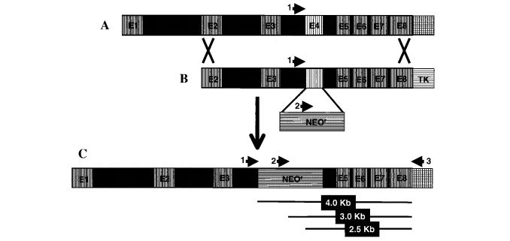
Background on Experiment
Mouse Model for Human Arginase Deficiency Developed
Molecular and Cellular Biology, 2002
Homologous Recombination
Arginase AI knockout mice completely lacked liver arginase (AI) activity, exhibited severe symptoms of hyperammonemia, and died between postnatal days 10 and 14

Slide 4
Background on Experiment
AAV-based gene therapy prevents neuropathology and results in normal cognitive development in the hyperargininemic mouse
Gene Therapy, 2013
Rescued the neurological mouse phenotype with the virus administration
Some derangement did occur later in life with decline in transgene expression
Mice did remain impaired in the handling of waste nitrogen (high ammonium levels)
Notes:
AAV = adeno-associated virus

Slide 5
Purpose for Experiment
People with Arginase I deficiency suffer from intellectual disability
Why?
The accumulation of ammonia and arginine (among other guanidino compounds) is suspected to cause neurological problems
How?
Ran a microarray analysis (Affymetrix Mouse 430 2.0 array) to get a better idea of what is happening in the transcriptome of the Arg 1 KO, Heterozygous, and treated KO (the AAV treated mice) compared to WT

Slide 6
Problem: Why So Much Arginase I Transcript but no Arginase I?
Arginase I transcript was found to be the most over-expressed gene between WT and KO (logFC = 3.64, adj.P.Val = 6.63e-10)
Due to probe binding issues, ie. wrong transcript binding, false signal?
Due to dysfunctional transcript being over-produced?
Most likely due to a dysfunctional transcript being over-produced!

Slide 7
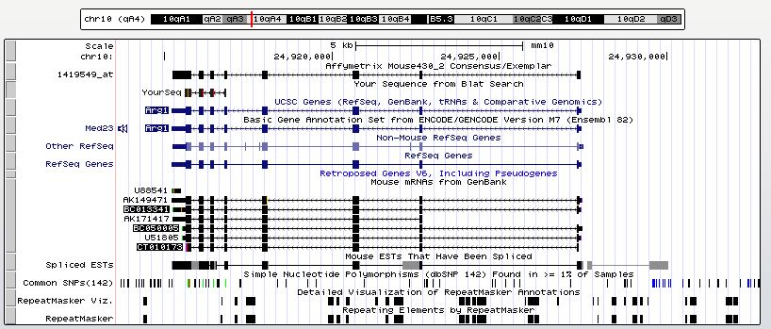
Probe Investigation
YourSeq = Affymetrix Mouse 430 2.0 Array Probes for Arg1
3’ 5’
Only exons 5 – 8 are covered by the probes (exon 4, the KO exon, is not covered)

Slide 8
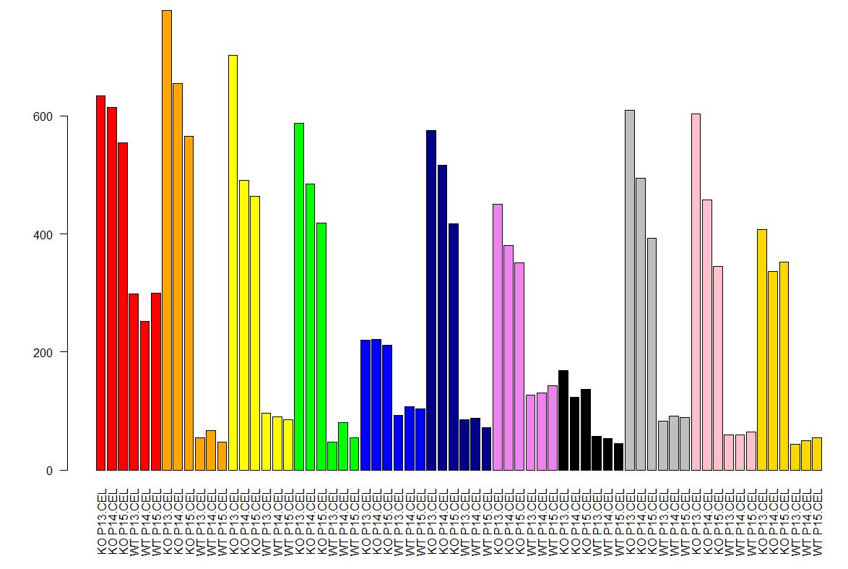
Probe Investigation
5’ 3’
Exon 5 Exon 8

Slide 9
Microarray Analysis
Faulty transcript is most likely being over-expressed in KO
How does this effect the transcriptome?
Will the transcriptome provide any insight into disease mechanisms, or at least highlight pathways of interest?
Differential Expression and WGCNA
12 samples: 3 KO, 3 WT, 3 Treated KO (TR), 3 HET (heterozygous)
Obtain Raw Data
Normalization (rma)
Remove Batch Effects
Consolidate Probes
Run T-Test/Extract Coefficients (acquire logFC)
Find Soft-Threshold Value
Run WGCNA
Analyze modules

Slide 10
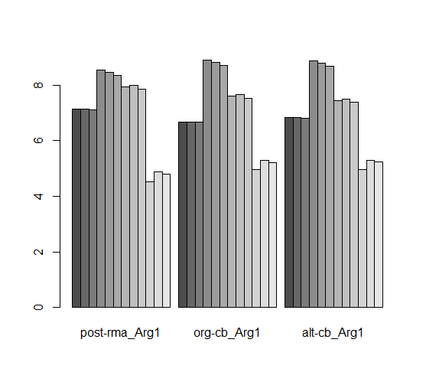
Arg1 Normalized Expression
HET | KO | TR | WT
Batch 2 | Batch 1 | Batch 2 | Batch 1
 | HET.P13 | HET.P14 | HET.P15 | KO.P13 | KO.P14 | KO.P15. | TREATED.KO.P13 | TREATED.KO.P14 | TREATED.KO.P15 | WT.P13 | WT.P14 | WT.P15
post-rma_Arg1 | 7.128559 | 7.125183 | 7.100202 | 8.537699 | 8.444088 | 8.33478 | 7.919216 | 7.982603 | 7.847139 | 4.528759 | 4.87154 | 4.801212
org-cb_Arg1 | 6.678866 | 6.675784 | 6.652978 | 8.888563 | 8.79915 | 8.694745 | 7.59669 | 7.65456 | 7.530887 | 4.958445 | 5.28585 | 5.218677
alt-cb_Arg1 | 6.837658 | 6.834572 | 6.811727 | 8.873728 | 8.784144 | 8.679538 | 7.436393 | 7.494359 | 7.370481 | 4.974736 | 5.302769 | 5.235467
Org (data-informed): TR=KO, HET=WT
Alt (phenotype-informed): TR=WT, HET=KO

Slide 11
Run T-Test/Extract Coefficients
Formed model based on genotype (dx) only, since most other variables are the same across samples (sex, species), had no significant effect on the model (age), or have been adjusted for already (batch, background)
Observation: Mice from each genotype were distributed between ages P13, P14, and P15, but the addition of this age variable to the dx only model did not effect the logFC values for dx (spearman correlation of 1, p<1e-200)
And, conversely, the addition of dx to an age only model did not effect the logFC value of age
Note – the age only model only had ~10 significantly differentially expressed genes
Investigation: Run ANOVA on dx models with and without addition of age, to see if adding age to the model improves its ability to predict datExpr gene expression values
Average Pr(>F) = 0.390 (average across all genes)
Conclude that the addition of age does not add anything meaningful to a model of this system with dx only
The effects of age and dx on datExpr seem to be very independent of each other
Since we are interested in how dx contributes to datExpr (and not interested in the effect of age), settle on a model with only the effects of dx (datExpr ~ dx)
Thus, no variables to regress out prior to WGCNA

Slide 12
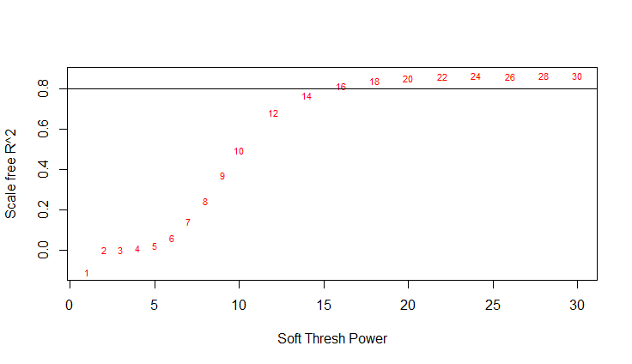
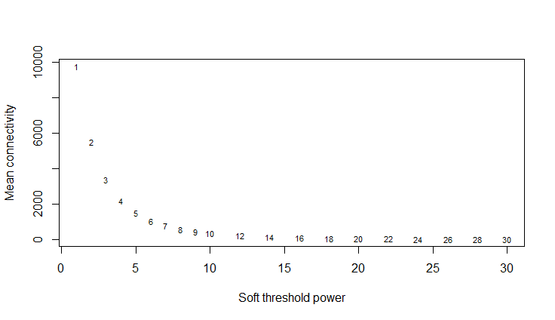
Choose Soft-Threshold
Choose Soft-Threshold of 18
Signed network, corFnc bicor

Slide 13
WGCNA
Final datExpr object had 19,417 genes
After recutting tree to choose optimal parameters:
minModSize 200
cutHeight 0.1
deepSplit 2
pamStage FALSE

Slide 14
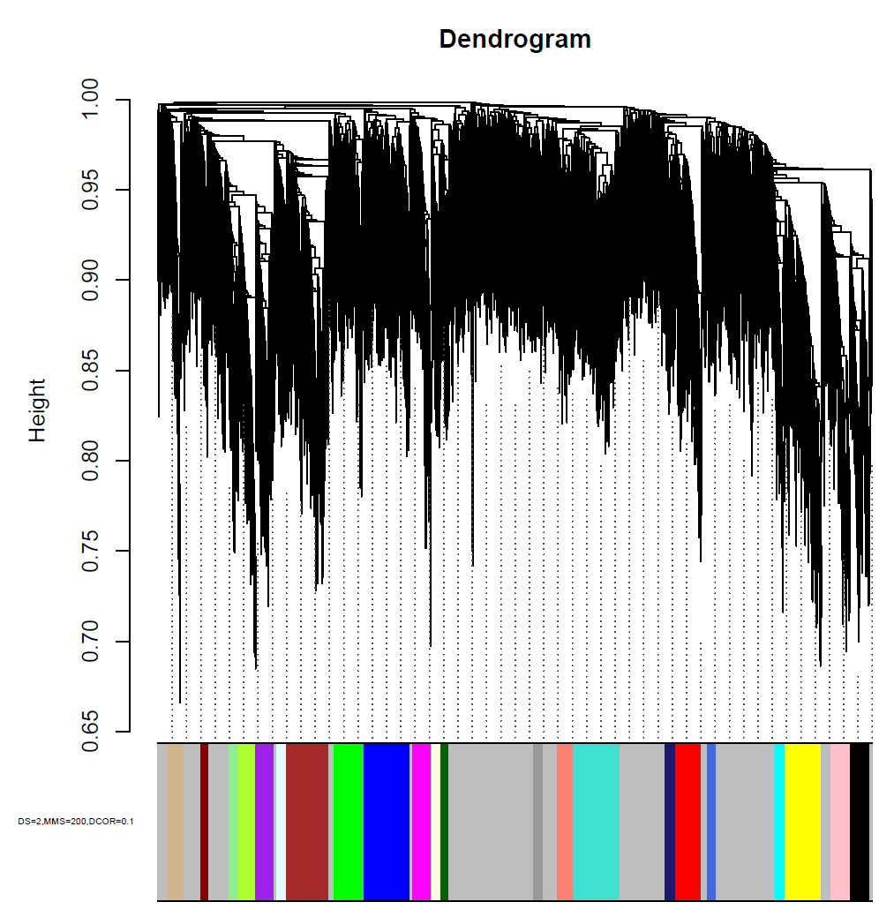

Slide 15
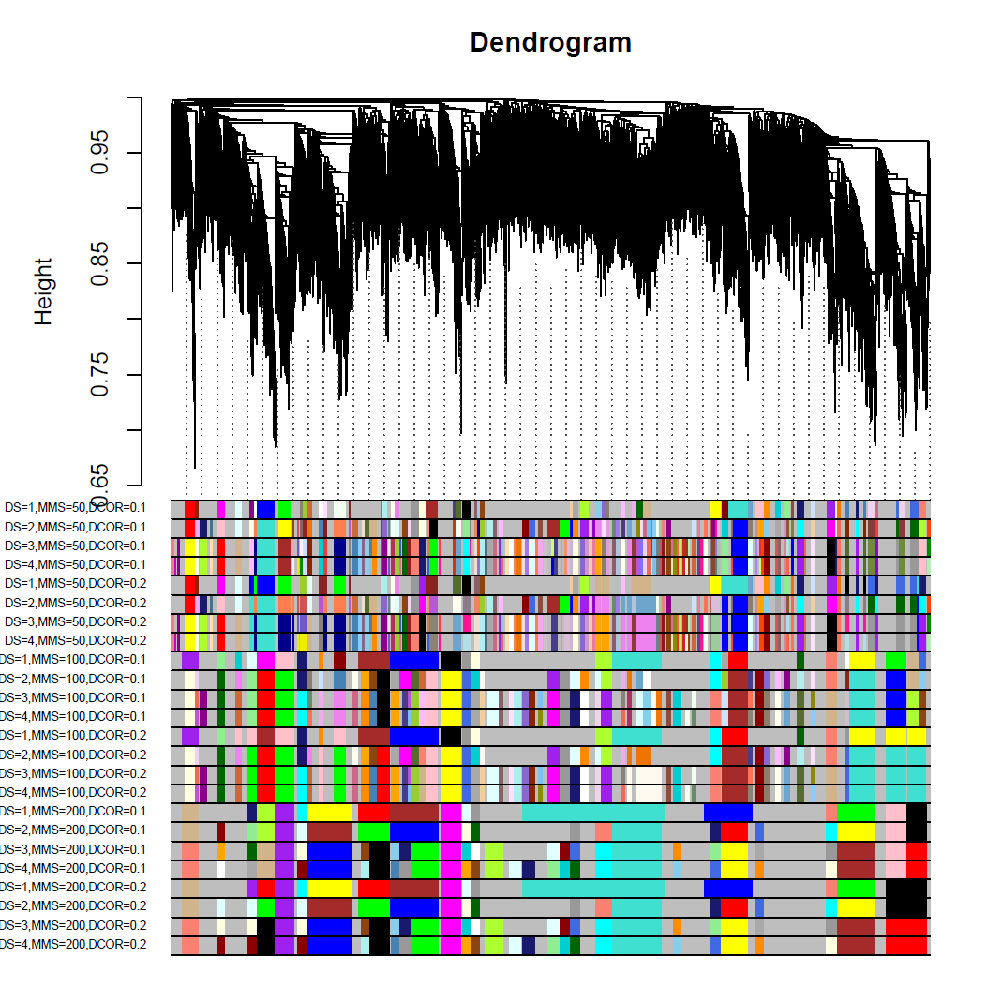

Slide 16
Investigate Modules
Pearson and Spearman Correlation of Module Eigengenes with Dx Vector (WT and KO only)
Student Asymptotic P-Value
ANOVA P-value (of F Ratio) (lm(ME~Dx))
Look for Enrichment of Significantly Differentially Expressed Genes in Modules
(# diff expr genes in module)/(# genes in module)
GO Elite (gene ontology)
Cell Type Correlations
CellMix, linear model
pSI, essentially a fisher test
Examine individual hub genes in over/under expressed modules in KO
Hub Gene = high kME (corr with ME) AND high kIN (high intra-modular connectivity) AND high + significant Gene Significance (correlated or anti-correlated significantly with KO)

Slide 17
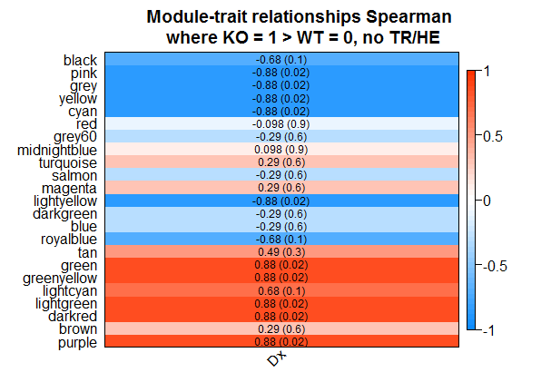
Notes:
Correlations the same for some modules bc Spearman is based on ranking – if two eigengenes have same ordering/ranking for KO’s and WT’s then the same correlation will occur.
ME ~ KO 13 KO 14 KO 15 WT 13 WT 14 WT 15

Slide 18
Module Enrichment Filtering
Further filter for interesting modules based on amount of enrichment (does this module contain many significantly differentially expressed genes)?
Since we only have 6 samples to compare to module eigengenes, we can’t trust the p-values produced from module eigengene correlations alone
Up-Regulated Modules
Darkred, green, greenyellow, lightgreen, purple
Toss out darkred and green from focus of analysis due to lack of enrichment
Down-Regulated Modules
Cyan, lightyellow, pink, yellow
Toss out lightyellow from focus of analysis due to lack of enrichment
Reminder – enrichment defined as
(# sig diff expr genes in module)/(# genes in module)

Slide 19
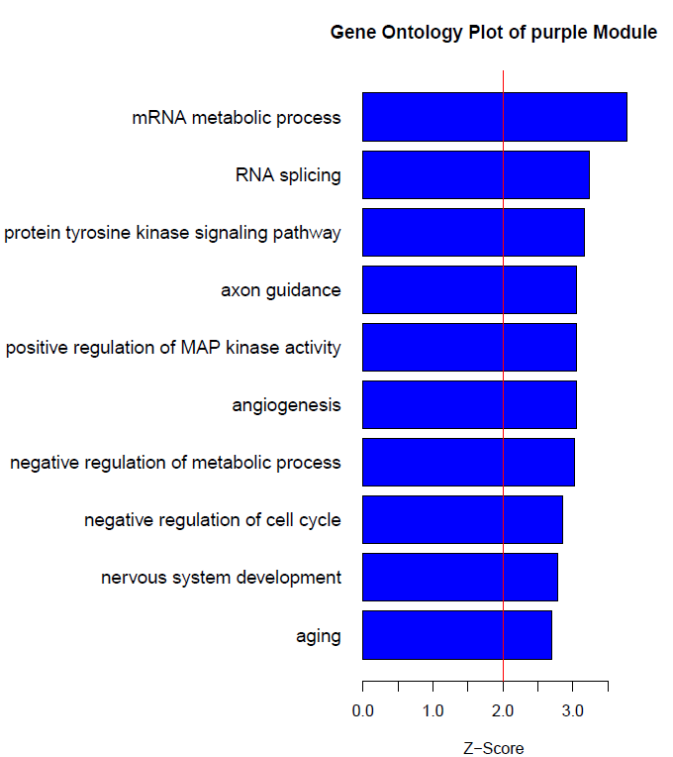
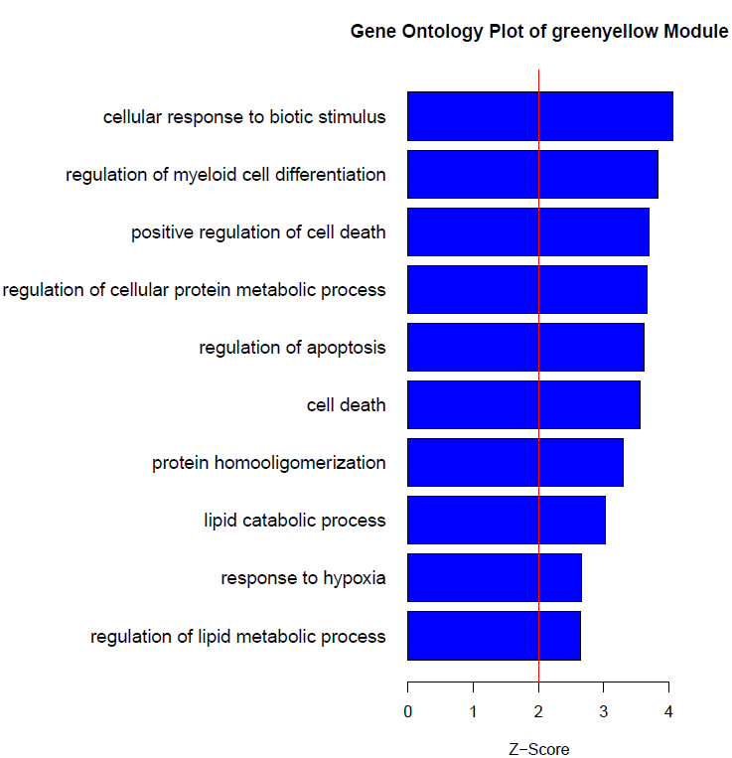
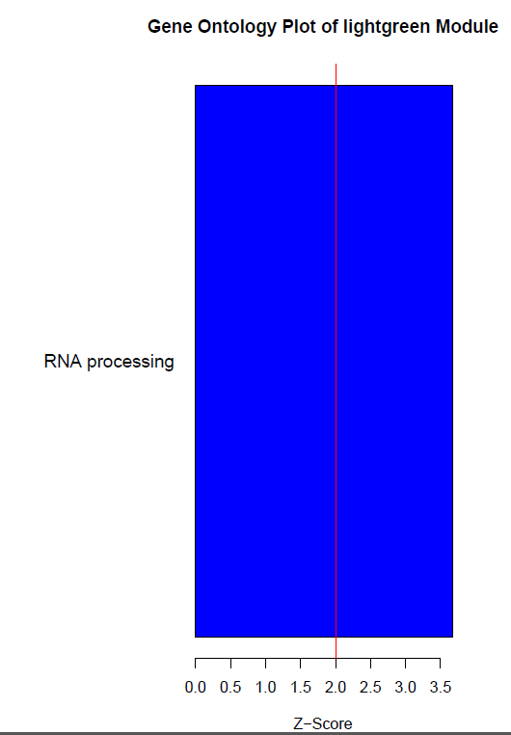
GO Results (Up-Regulated)
<- Arg1

Slide 20
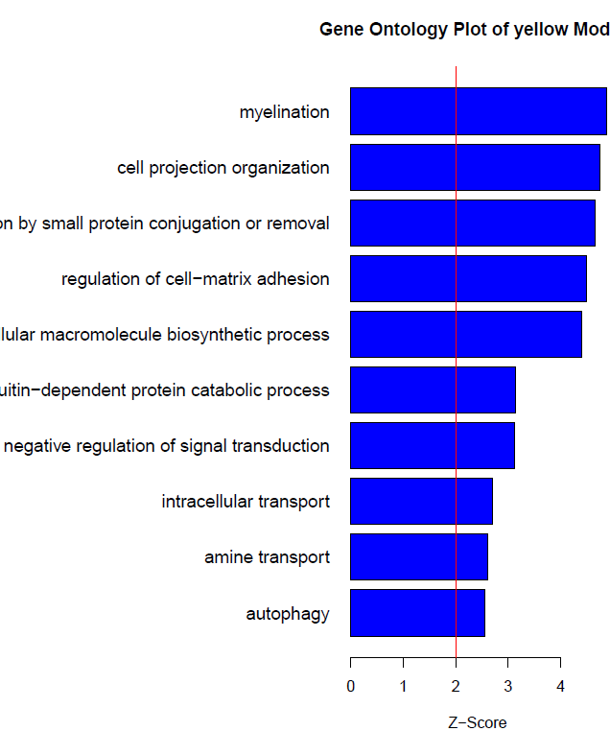
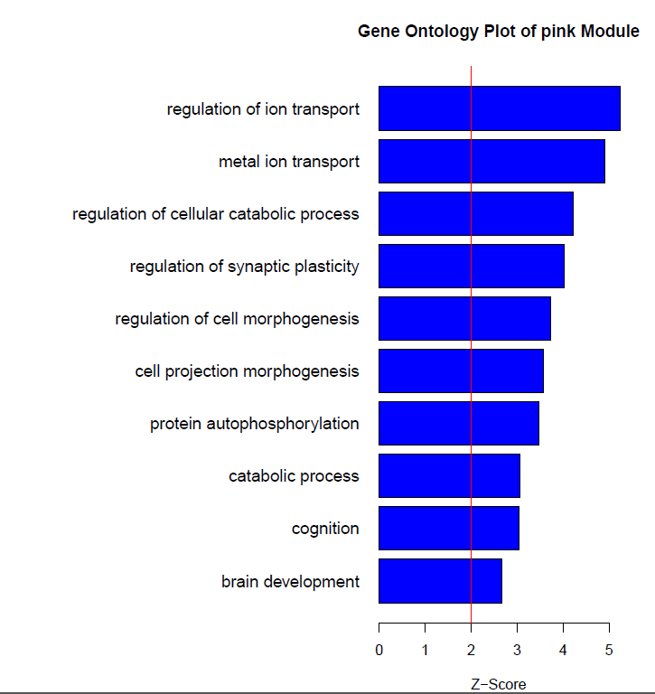
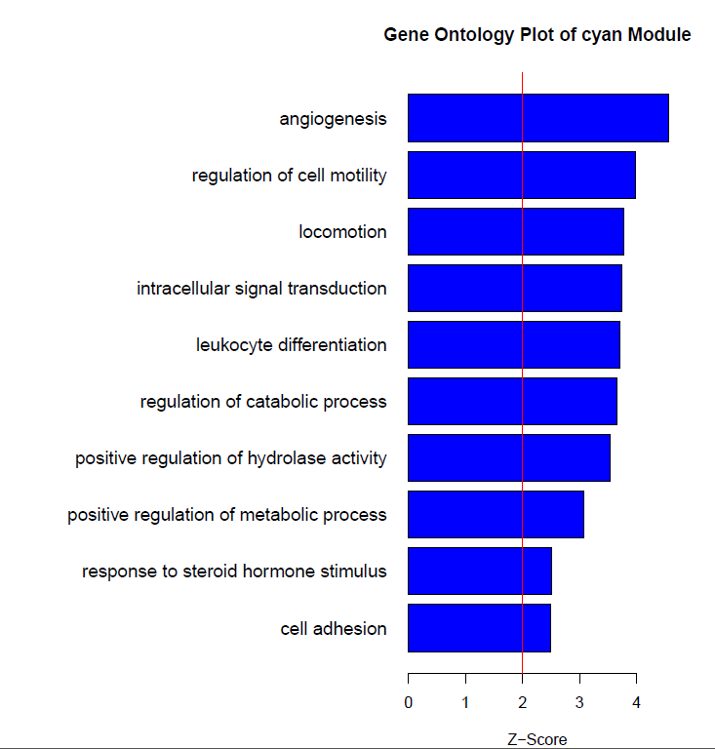
GO Results (Down-Regulated)

Slide 21
Summary + Cell Type Correlations
Module | Size (# genes) | DiffExpr (# diff expr genes) | Enrichment (DiffExpr/Size) | Top GO | Corr_With_KO (Pearson) | Corr_With_KO (Spearman) | pCorr_With_KO (Pearson) Student Asymptotic p-value | pCorr_With_KO (Spearman) Student Asymptotic p-value | pANOVA | Positive CellTypeCor CellMix, kruskal-wallis p | pSI Enrichment p adj. fisher
cyan | 286 | 155 | 0.541958042 | angiogenesis/regulation of cell motility | -0.93 | -0.88 | 0.00001 | 0.02 | 8.80E-05 | NF Oligo? P = 0.094 | Endo, 7e-12
green | 827 | 31 | 0.037484885 | positive regulation of phospholipase activity | 0.82 | 0.88 | 0.001 | 0.02 | 0.015 |  | Astro, 0.004
greenyellow | 462 | 304 | 0.658008658 | cellular response to biotic stimulus | 0.92 | 0.88 | 0.00002 | 0.02 | 3.90E-06 |  | Endo, 0.003? Astro, 0.04?
lightgreen | 256 | 117 | 0.45703125 | RNA processing | 0.8 | 0.88 | 0.002 | 0.02 | 1.50E-03
pink | 512 | 201 | 0.392578125 | regulation of ion transport | -0.81 | -0.88 | 0.001 | 0.02 | 2.30E-03 | NF Oligo? P = 0.054
purple | 496 | 128 | 0.258064516 | mRNA metabolic process | 0.7 | 0.88 | 0.01 | 0.02 | 6.50E-03 |  | NE, 1e-10
yellow | 976 | 490 | 0.50204918 | myelination | -0.92 | -0.88 | 0.00002 | 0.02 | 2.80E-04 | NF Oligo, P = 0.049 | Myelin. Oligo, 0.001

Slide 22
Cyan (down-regulated)
Top GO: angiogenesis/regulation of cell motility
Highest kIN (of 1): Zbtb34
Gene Cards: a zinc finger protein, may be a transcriptional repressor
2nd most under-expressed gene: Chrdl1
Expression suggested to play a role in retinal angiogenesis in response to hypoxia
Also known to be expressed differentially in normal fetal development and supposed to be highly expressed in normal neocortex
Could this under-expression be related to downregulation of angiogenesis in these mice?
pSI significantly correlated with endothelial cells
Notes:
Angiogenesis – formation of blood vessels in the brain

Slide 23
Green (up-regulated)
pSI significantly correlated with astrocytes
Top GO: positive regulation of phospholipase activity
Consistent with toxic injury to nervous system
Not significantly enriched though

Slide 24
Greenyellow (up-regulated)
Contains Arg1 (most significantly up-regulated transcript)
Top GO: Cellular Response to biotic stimulus
Significantly pSI correlated with endothelial cells, also astrocytes (not as much – 0.003 v. 0.04)
Perhaps the lack of arginase is messing up the diffusion of vital molecules through blood-brain barrier (hence upregulated cellular response to biotic stimulus), hindering neural development?
Arginase and nitric oxide (NO) synthases (NOS) compete to degrade l-arginine. So more NO due to NOS's busy degrading I-arginine?

Slide 25
Lightgreen (up-regulated)
Top GO term: RNA processing
Potentially a response to too much bad Arg1 transcript?

Slide 26
Pink (down-regulated)
Top GO term: regulation of ion transport
Almost significantly correlated with newly-formed oligodendrocytes (CellMix), maybe contributing to down-regulation of these cells

Slide 27
Purple (up-regulated)
Significantly correlated with neurons (pSI)
Top GO Term: mRNA metabolic process
Another module responding to too much bad Arg1 transcript?

Slide 28
Yellow (down-regulated)
Top GO term: myelination
CellMix and pSI both significantly correlated with myelinating oligodendrocytes
Myelination downregulated in KOs?
Tek gene (most down-regulated yellow module gene) – involved in embryonic vascular development (gene cards)
Usp25 gene (highest kIN) – involved in regulation of protein breakdown, cell cycle regulation and stress response
Case Study: The magnetic resonance imaging (MRI) of our case showed severe multicystic cerebral white matter lesions with cortical atrophy, which were more severe compared with previous reports
http://www.sciencedirect.com/science/article/pii/S038776041000063X
Notes:
Multicystic = multiple regions
Cortical atrophy = cortical ‘waste away’

Slide 29
Future Directions + Questions
Efficient ways to look at module membership, gene significance, significant differential expression, and intra-modular connectivity when identifying genes of interest?
Validation Strategies
Checked out a down’s syndrome study in humans – no correlation (unable to find an ID study)
How to prioritize modules and genes to research?
Further investigate blood brain barrier and myelination? Could they be acting together, or one effecting the other?

Slide 30
To-Do
ReRun Analysis with Conservative ComBat (don’t try to preserve disease differences)
Also look at diff sft thresh?
Add to analysis:
Fisher test of dx in modules
plot module eigengenes by dx (all 4)
anova, with all 4, followed by tukey post-test
Enrichment of ID genes in modules
Show module conservation in mouse allen developing brain dataset
PPI enrichment
Questions to get at
Is ID being caused by lack of functional Arg1 OR from hyper-ammonemia
*Lit search on this
Wt + het have similar ammonia levels , and het don’t show behavior difficulties
TR KO have elevated arginine levels (not as high as KO), WT and HE have comparable arginine levels (lowest)
Taurine amino acid elevated (investigation in animals)
The transcript is not differentially expressed in our mice
What cells are dying (myelinating oligodendrocytes? Blood brain barrier/endothelial deterioration)
histology (wet lab)
Do a PCR on remaining tissue to see what is happening to exons 1-3 in transcript of Arg1
*When does blood brain barrier develop in mice?
*Function of other Arginases in brain+liver?
*When is Arginase1 expressed in the brain? (Human+Mouse Brain alan atlas)
*Austin – look into the ubiquitination pathway genes being tagged by modules (tan, salmon, and magenta)
- in Mod_Gene_Qualities_CBPure_KO.xlxs
Do we see similarities with fetal alcohol syndrome people and/or model mice?
*Maybe check out the most differentially expressed genes in new modules
Low white matter identified in other Arg1 mice or ID model mice?
Future
Look at a conditional knock out mouse (brain only) and see changes in morphology, gene expression

Slide 31
Jill To-Do (ArgMouse2.R)
Re-Run current analysis with Conservative ComBat (CBPure) datExpr (ArgMouse.R)
*’test3’ folder has the CBPure analysis (unlike proc)
Final chosen dataset
Replicate IntMods Folder
Replicate Mod_Gene_Qualities
Fisher Test – see Mod_Gene pdfs
Differentially expressed genes ORA in modules
Plot Module Eigengene of all 4 phenotypes – ME_Boxplot.pdf
Boxplot
Do + Plot ANOVA of all 4 phenotypes – ME_Dx_Correlation.pdf
Tukey post-test
ORA/Enrichment of ID suspect genes in modules
Validation
Allen Developing Mouse Brain – module preservation
Fetal Alcohol Syndrome (Mouse + Human)
Do we observe similar module dysregulation?
What exactly is Fetal Alcohol Syndrome?
PPI Enrichment in Modules
Check out Taurine and other highlighted genes from Gerry+Austin
Taurine in grey module, not differentially expressed

Slide 32
KO v. TR v. HE
Modules Dysregulated in All
Brown (up)
Contains Arg1, endothelial cells, positive regulation of mRNA processing
Midnightblue (down)
Angiogenesis, endothelial cells, and transcription regulation
Salmon (down)
Myelination, MO cells, and ubiquitin dependent protein catabolic process
KO only
Cyan (up)
DNA metabolic process
Lightyellow (up)
Neurons, Axon guidance + negative regulation of gliogenesis
Red (down)
MO cells, regulation of synaptic plasticity + neurotransmitter secretion
KO and TR only
Tan (down)
Protein polyubiquitination
Yellow (down)
Endothelial cells, angiogenesis, cell adhesion + migration
KO and HE only
Magenta (up)
RNA processing and proteasomal protein catabolic process
Pink (up)
Neurons, positive regulation of translation and RNA localization

Slide 33
KO v. TR v. HE
KO
All Arg1 is dysfunctional
High Arginine
High Ammonia
TR
Dysfunctional Arg1 transcript fully present
But functional Arg1 transcript also present
Natural biological pathways to get more Arg1 only produce dysfunctional Arg1 (completely ineffective in getting functional Arg1)
High Arginine (more than WT/HE less than KO)
HE
½ Arg1 transcript is dysfunctional
However ½ of Arg1 is functional
Natural biological pathways have reduced efficiency

